Slide 1
Short discussion on U and statistics of nonlinear models

Slide 2
Stats summary
Given a distribution, can find likelihood of observing a value equal or greater to a single measurement
Null distribution has to be known
Null distribution is the expected range of a given number
p values is odds of observing some range of values in the population

Slide 3
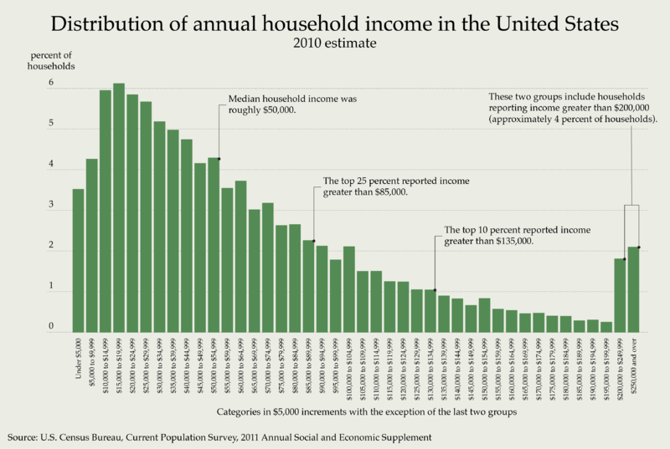
What fraction of the US makes as much money or more than a current ChE/BioE graduate student?
Answer: ~66%
Starting salary post graduation: ~14% (average about $110K)
Note: Technically in correct. I could only find household incomes, not individual. Should include room mates…

Slide 4
Stats summary
For t tests, U tests and so on, we are asking a fundamentally different question
Does my data come from a specific population?
Did my data come from a normal population with a mean of mu?
Or do my two sets of data come from the same population?
A good question: Can you just calculate p value for each measurement and average them?
But what would that even mean?

Slide 5
What fraction of the US makes as much money or more than a current ChE/BioE graduate student?
Situation 1:
If we have one current graduate student and one recent graduate, with a one sided p = .66 and .14, what are the odds of randomly meeting 2 people with salaries of $31K and $100K?
Ans: .8
Situation 2:
We meet 15 people in Tokyo and get their annual salaries. Are people in Tokyo paid more than people in the US?
These are fundamentally different questions. Situation 2 requires us to understand how either the average, the t score, the U score, etc. distributes when taking measurements from the US salary distribution.

Slide 6
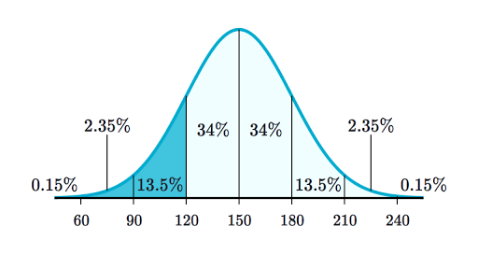
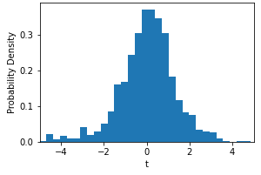
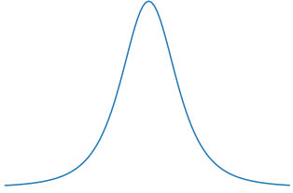
Tokyo Salaries (K)
$75
$90
$52
$88
5. Determine where your measured statistic falls on the distribution. What are the odds our data came from our reference??
4. Apply statistic to your data
1. Get some data:
t = 1.07
3. Choose a statistic to summarize your measurements and determine how it is expected to distribute
p = 0.18 of t > = 1.07
18% chance of observing t > = 1.07 when sampling a normal population with a mean of $75K.
2. Choose a reference/comparative population. Often a normal population
$75K
US Salaries
Notes:
we can’t ask questions in a void
import scipy.stats as stats
import numpy as np
import matplotlib.pyplot as plt
plt.plot(np.arange(-5,5,.1), stats.t.pdf(np.arange(-5,5,.1), 3))
plt.xlabel("t")
plt.ylabel("PFD")
dat = [120,90,52,99];
t_value = (np.mean(dat)-75)/np.std(dat,ddof = 1)*np.sqrt(4)
print(t_value)
print(1- stats.t.cdf(t_value,df = 3))
stats.ttest_1samp(dat, popmean = 75, alternative="greater")

Slide 7
The choices we made
What is our reference population
What is our statistics
Do we want greater, lesser or both

Slide 8
Specific to our discussion on income, what is wrong with how the statistic is developed?

Slide 9
Tokyo Salaries (K)
$75
$90
$52
$88
5. Determine where your measured statistic falls on the distribution. What are the odds our data came from our reference??
4. Apply statistic to your data
1. Get some data:
3. Choose a statistic to summarize your measurements and determine how it is expected to distribute
2. Choose a reference/comparative population. Often a normal population
?
Won’t get a classic distribution
$75K
US Salaries
Notes:
we can’t ask questions in a void
import scipy.stats as stats
import numpy as np
import matplotlib.pyplot as plt
plt.plot(np.arange(-5,5,.1), stats.t.pdf(np.arange(-5,5,.1), 3))
plt.xlabel("t")
plt.ylabel("PFD")
dat = [120,90,52,99];
t_value = (np.mean(dat)-75)/np.std(dat,ddof = 1)*np.sqrt(4)
print(t_value)
print(1- stats.t.cdf(t_value,df = 3))
stats.ttest_1samp(dat, popmean = 75, alternative="greater")

Slide 10
Stats summary
For t tests, U tests and so on, we are asking a fundamentally different question
Does my data come from a specific population?
Did my data come from a normal population with a mean of mu?
Or do my two sets of data come from the same population?
A good question: Can you just calculate p value for each measurement and average them?
But what would that even mean?
Quick side note: t is popular because it has very nice mathematical properties when applied to a normal distribution (independent of mean, standard dev.)

Slide 11
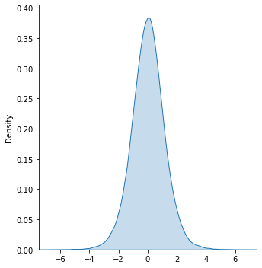
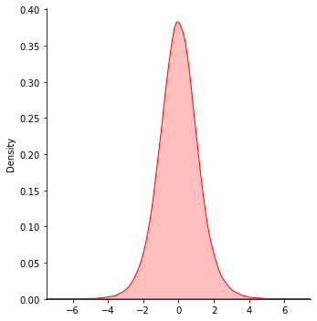
Homework: single sample and two sample null distributions are the same
2 sample t test
n = 5
DOF = 8
1 sample t test
n = 9*
DOF = 8
p value for t >= 1.86 for 1 sample t test, n = 9, is 0.04931
p value for t >= 1.86 for 2 sample t test, n = 5, is 0.04924

Slide 12
Homework: What if data is not from normal distribution?
One of my favorite questions to trip up people
We often have little to no evidence that specific data sets are actually normally distributed!!
So create assume a uniform distribution centered about the same mean as a normal distribution and estimate t distributions again
Remember t is just an equation!
What are reasonable bounds for our assumed uniform distribution?

Slide 13
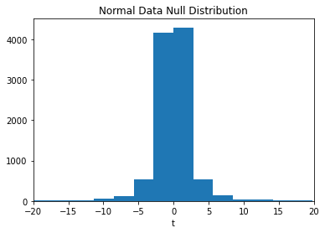
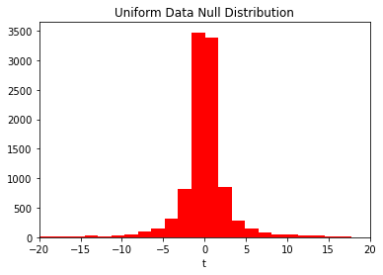
Homework 11: What if data is not from normal distribution?
When n = 3
p value for (t >= 4): 0.04
p value for (t >= 4): 0.06

Slide 14
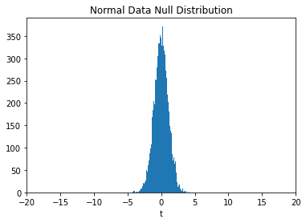
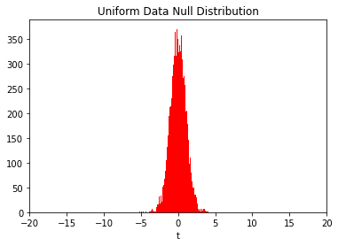
Homework: What if data is not from normal distribution?
When n = 30
p value for (t >= 4): 0.0003
p value for (t >= 4): 0.0001

Slide 15
Central limit theorem
In a nutshell: the distribution of a sample statistic approximates a normal distribution (i.e., a “bell curve”) as the sample size becomes larger regardless of the population's actual distribution shape
The theorem is a key concept in probability theory because it implies that probabilistic and statistical methods that work for normal distributions can be applicable to many problems involving other types of distributions
Often the magic number cited is n = 30 for when normalcy can be ignored

Slide 16
On to the new U!
We’ve got the t down pretty pat.
Seen that mild deviations in the population distribution don’t completely undo the value of a t test and that we can modify our t pipeline to consider uniform data
What if we have NO clue about the population distribution?
Enter: parameter free or nonparametric tests!!

Slide 17
The short version
A nonparametric test does not rely on a the data coming from a defined probability distribution
There are a lot of tests that fall in this area. These include:
Kaplan-Meier: estimates when significant changes in survival occurs using lifetime data
Kolmogrov-Smirnov: test if two samples are drawn from the same (yet undefined) populations
Log rank test
Spearman’s ranked correlation: determines if two variables are significantly correlated
Wilcoxon rank-sum test: tests if randomly selected values from one population are less than or greater than a randomly selected value from a second population

Slide 18
Wilcoxon rank-sum test
Used to investigate whether two independent samples were selected from populations having the same distribution
Unlike the t test which is (typically) specifically asking if the means are the same between two populations, the WRST does not actually test for an equality of means or medians.
Though often used as if it tested for differences in medians.
Is interesting to study because the null distribution is constructed in a completely different way than the null t distribution!!

Slide 19
WRST: the U
Like with t, the mean and the standard deviation, we need some statistic to summarize a populations.
U can is applied to ordinal data, i.e. data that can be ordered but the distances between the ordering is either unknown or ignored
How to calculate U for small data sets (i.e. direct method)
U is the number of “wins” between two competing datasets
For each observation in one set, count the number of times this first value wins over any observations in the other set.
Count 0.5 for any ties
The sum of wins and ties is the U for that datasets
To keep our discussion simple, we will ignore the case of ties

Slide 20
WRST: the U (no ties) using direct method
For example
Order the data by the wins (highest to lowest)
J B B B J J
Using the direct method, the U (U1) for Jason is the number of times each of his scores beats Bob’s.
3+ 0 + 0 = 3.
For Bob (U2):
2 + 2 + 2 = 6
Now we need a null distribution to figure out if getting either a 3 or a 6 is unlikely to occur by chance.
Fun fact: U1 + U2 = n1 * n2.
Jason's Score | Bob’s Score
100 | 90
55 | 80
50 | 60

Slide 21
U Null Distribution
Consists of all possible combination of outcomes. Let’s do with just 2 samples per group
Combinations
U1
JJBB
JBJB
JBBJ
BJBJ
BBJJ
BJJB
4
3
2
1
0
2
So if we had a result of JJBB, U1 = 4, we’d get a one-sided, “greater” p-value of 1/6. Check with R

Slide 22
U Null Distribution
[1,] 1 1 1 2 2 2
[2,] 1 1 2 1 2 2
[3,] 1 1 2 2 1 2
[4,] 1 1 2 2 2 1
[5,] 1 2 1 1 2 2
[6,] 1 2 1 2 1 2
[7,] 1 2 1 2 2 1
[8,] 1 2 2 1 1 2
[9,] 1 2 2 1 2 1
[10,] 1 2 2 2 1 1
[11,] 2 1 1 1 2 2
[12,] 2 1 1 2 1 2
[13,] 2 1 1 2 2 1
[14,] 2 1 2 1 1 2
[15,] 2 1 2 1 2 1
[16,] 2 1 2 2 1 1
[17,] 2 2 1 1 1 2
[18,] 2 2 1 1 2 1
[19,] 2 2 1 2 1 1
[20,] 2 2 2 1 1 1
What if we used our original situation of 3 measurements per group?
20 combinations to do calculations on…homework?

Slide 23
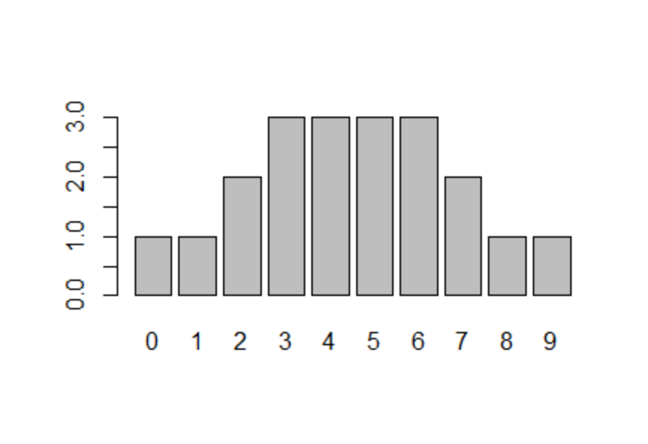
U Null Distribution
If 3 samples per group, use the null distr. Provided to calculate the one sided p value for the following data
a<-c(10,1,3);
b<-c(4,5,6);
Assuming that a group is “lesser” than b.
Check answer with mannwhitneyu test
To help, there are 20 data points in this histogram.

Slide 24
U Null for different sample sizes (i.e. DOF)
qqnorm() + qqline to determine how normal the distrib. is

Slide 25
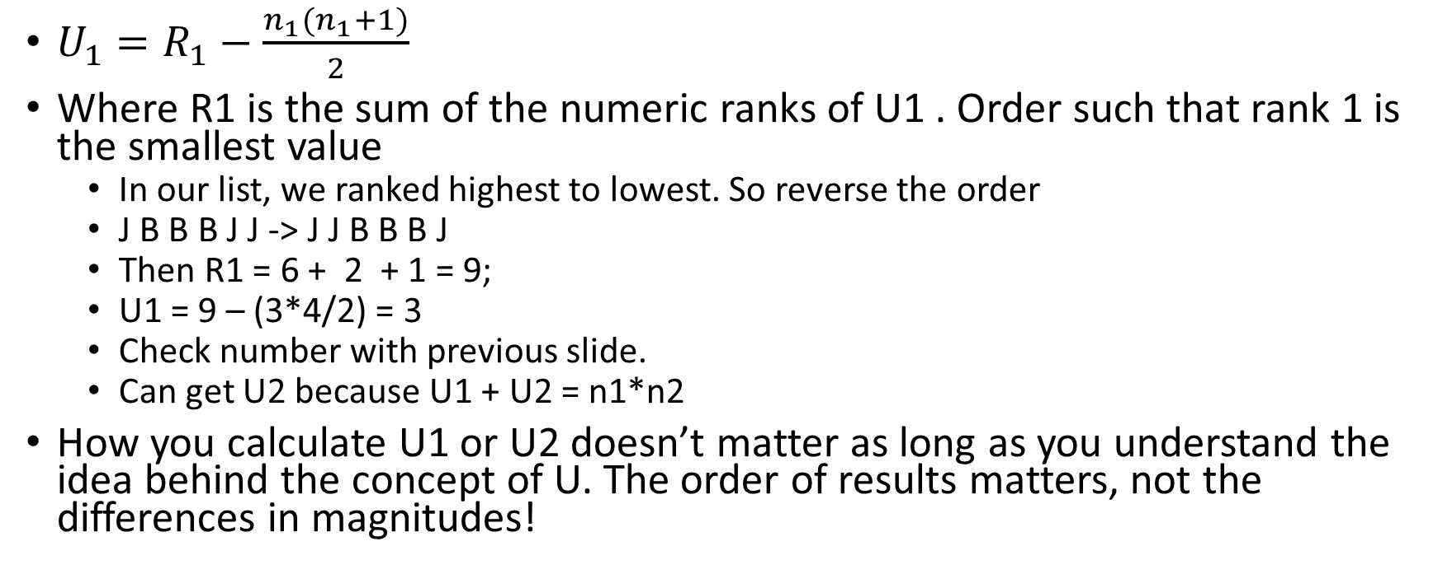
Thankfully, there is a faster way to calculate U1 (indirect method)
$U_{1}=R_{1}−\frac{n_{1}(n_{1}+1)}{2}$
Where R1 is the sum of the numeric ranks of U1 . Order such that rank 1 is the smallest value
In our list, we ranked highest to lowest. So reverse the order
J B B B J J -> J J B B B J
Then R1 = 6 + 2 + 1 = 9;
U1 = 9 – (3*4/2) = 3
Check number with previous slide.
Can get U2 because U1 + U2 = n1*n2
How you calculate U1 or U2 doesn’t matter as long as you understand the idea behind the concept of U. The order of results matters, not the differences in magnitudes!

Slide 26
U vs t
Possible benefit of U is that we don’t need to assume anything on the behavior of the noise associated with the population being measured
The weakness though is that we lose some power in detecting differences when large differences exists
Easy example: use wilcoxon and t.test to compare datasets a and b where a <- c(1,2,3) and b <- c(10000,15000,20000)
But can sometimes provide a better p value if one data set has a vary high degree of variability
Try a <- 1:3 and b <- c(5,6,30);
This might happen when the assumption of normalcy was wrong or the data has vary large standard deviations (especially important for small sample sizes)

Slide 27
Statistics of nonlinear models
Short version: There are not standard statistical tests of signficance for nonlinear models

Slide 28
Statistics of nonlinear models
One more time: we’ve shown that t tests are linear models
Therefore, we can use t distributions to determine the significance of the parameters of a fitted linear model
The hypothesis is that the slopes of our fitted linear model are zero
So how can we assess the significance (p value) of fitted parameters for nonlinear models?
Can we use t distributions? NO! Those are based on linear models
Unlike linear models, nonlinear regression models can take on virtually an infinite number of forms
We would have to refine the null hypothesis/null distribution for each type of nonlinear model!

Slide 29
Bootstrapping to estimate the significance of nonlinear regression fits (intro only)
The basic idea:
Approach 1: given an estimate of the confidence interval of the data, randomly select values in the confidence interval
Approach 2: “resample with replacement” If have 5 data points, select randomly 5 values from that list, replacing values each time. e.g. we might 'resample' 5 times from [1,2,3,4,5] and get [2,5,4,4,1]
perform regression (gradient descent, minimize, fsolve)
Repeat 1000’s of times to create a distribution of the models parameters for which the model’s output fits in the confidence intervals.
Assess the fraction of the distribution that crosses zero

Slide 31
Bootstrapping to determine significance of nonlinear regression fits
The problems:
No fully established method for time course data
Do you allow each time points to have individual confidence ranges OR do you pull all the data to create a common confidence interval for all time points?
You must make decisions on how you define the error ranges sampled
Regression algorithm may fail to find solutions
Have to throw out runs that fail
Regression algorithm may fail to identify multiple minima
Multiple minima results in multimodal distributions
Very computationally expensive
If nonlinear ODEs are stiff, very slow process
Even if regression fits model to data, the model still might not always make sense

